Slide 1
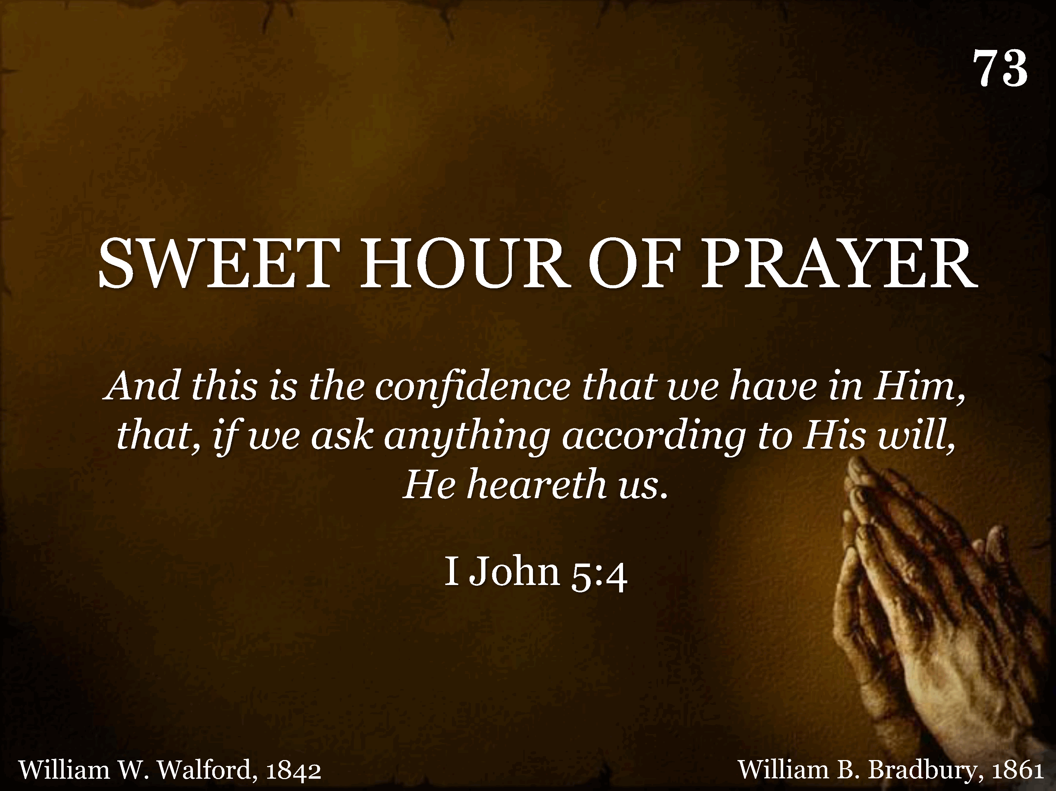
073 - Sweet Hour Of Prayer - Title
CCLI #21593236

Slide 2
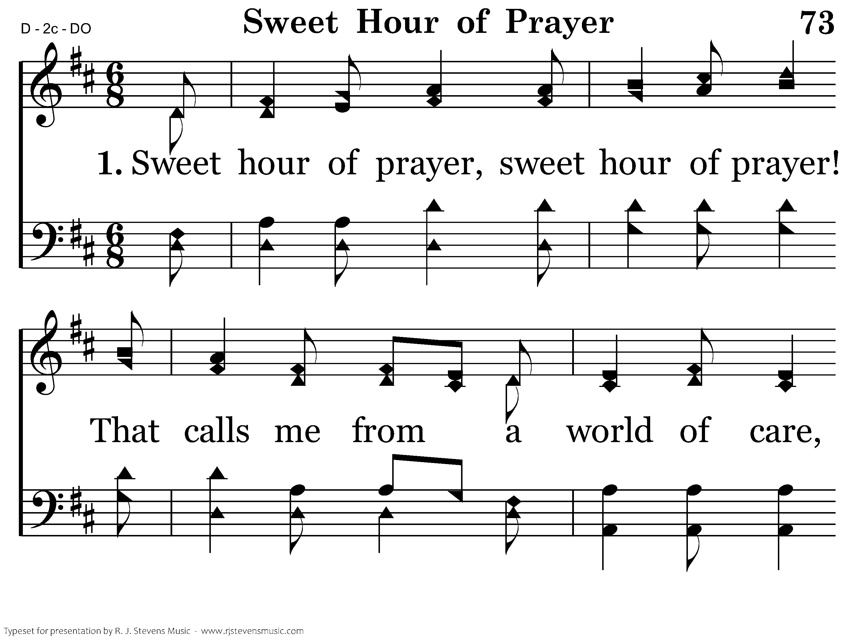
073 - Sweet Hour Of Prayer - 1.1
CCLI #21593236

Slide 3
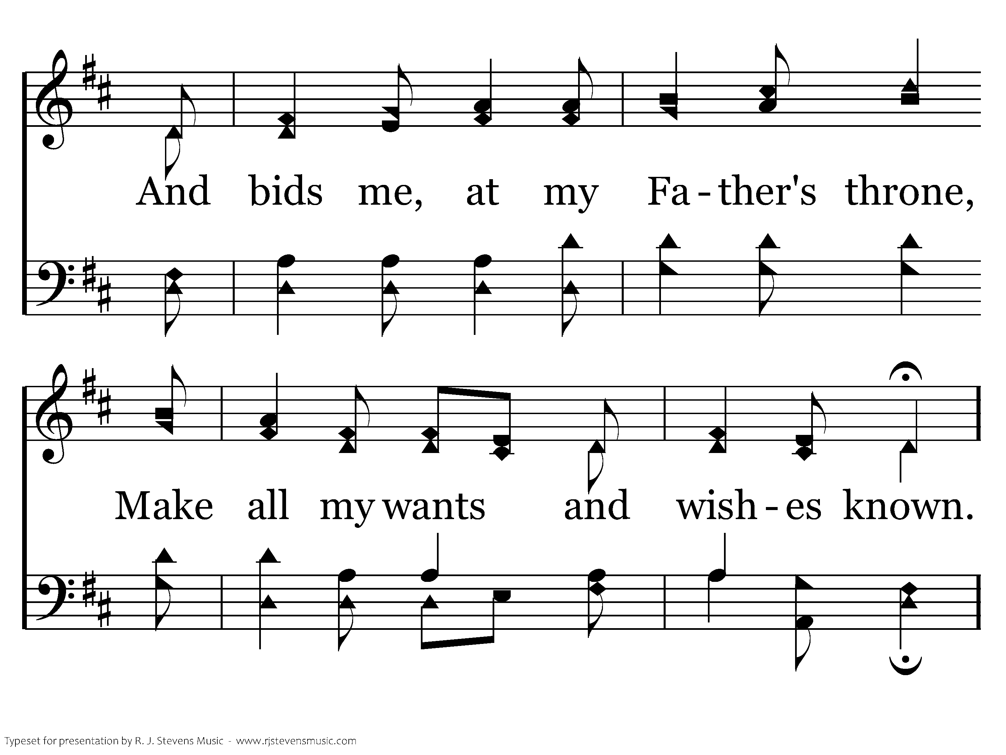
073 - Sweet Hour Of Prayer - 1.2
CCLI #21593236

Slide 4
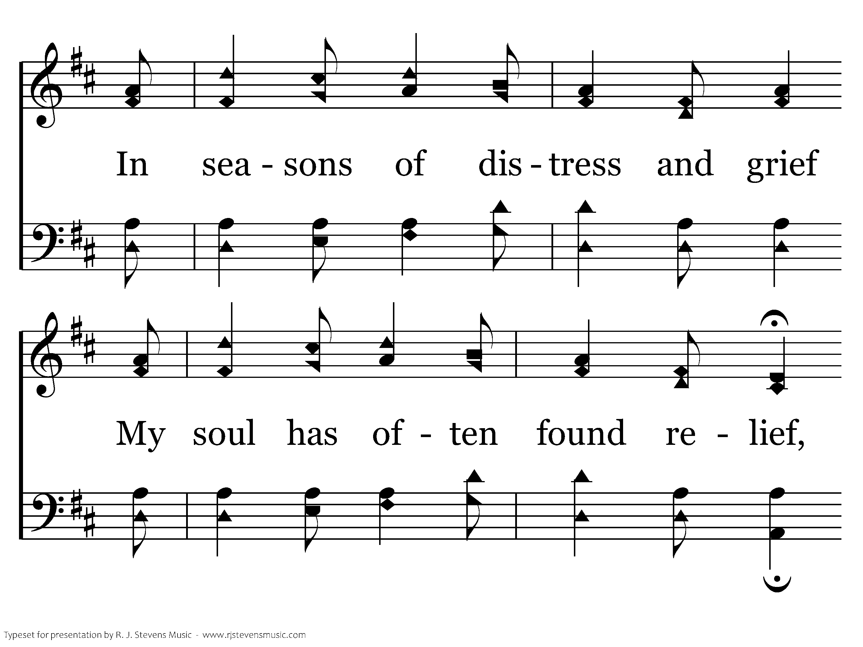
073 - Sweet Hour Of Prayer - 1.3
CCLI #21593236

Slide 5
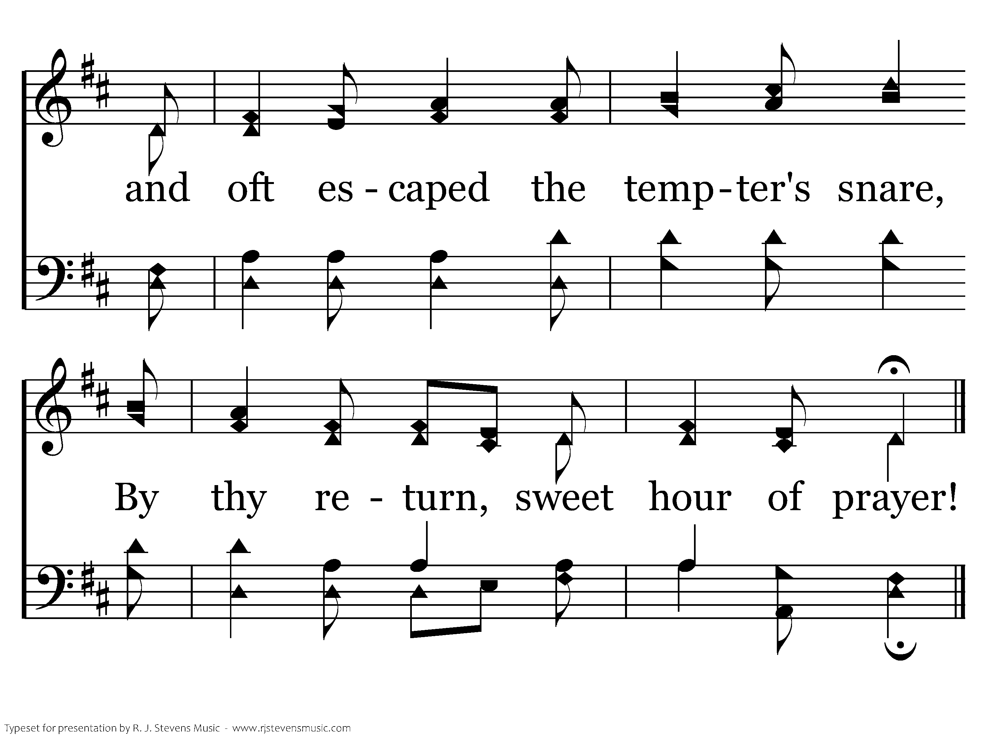
073 - Sweet Hour Of Prayer - 1.4
CCLI #21593236
End of Verse 1

Slide 6
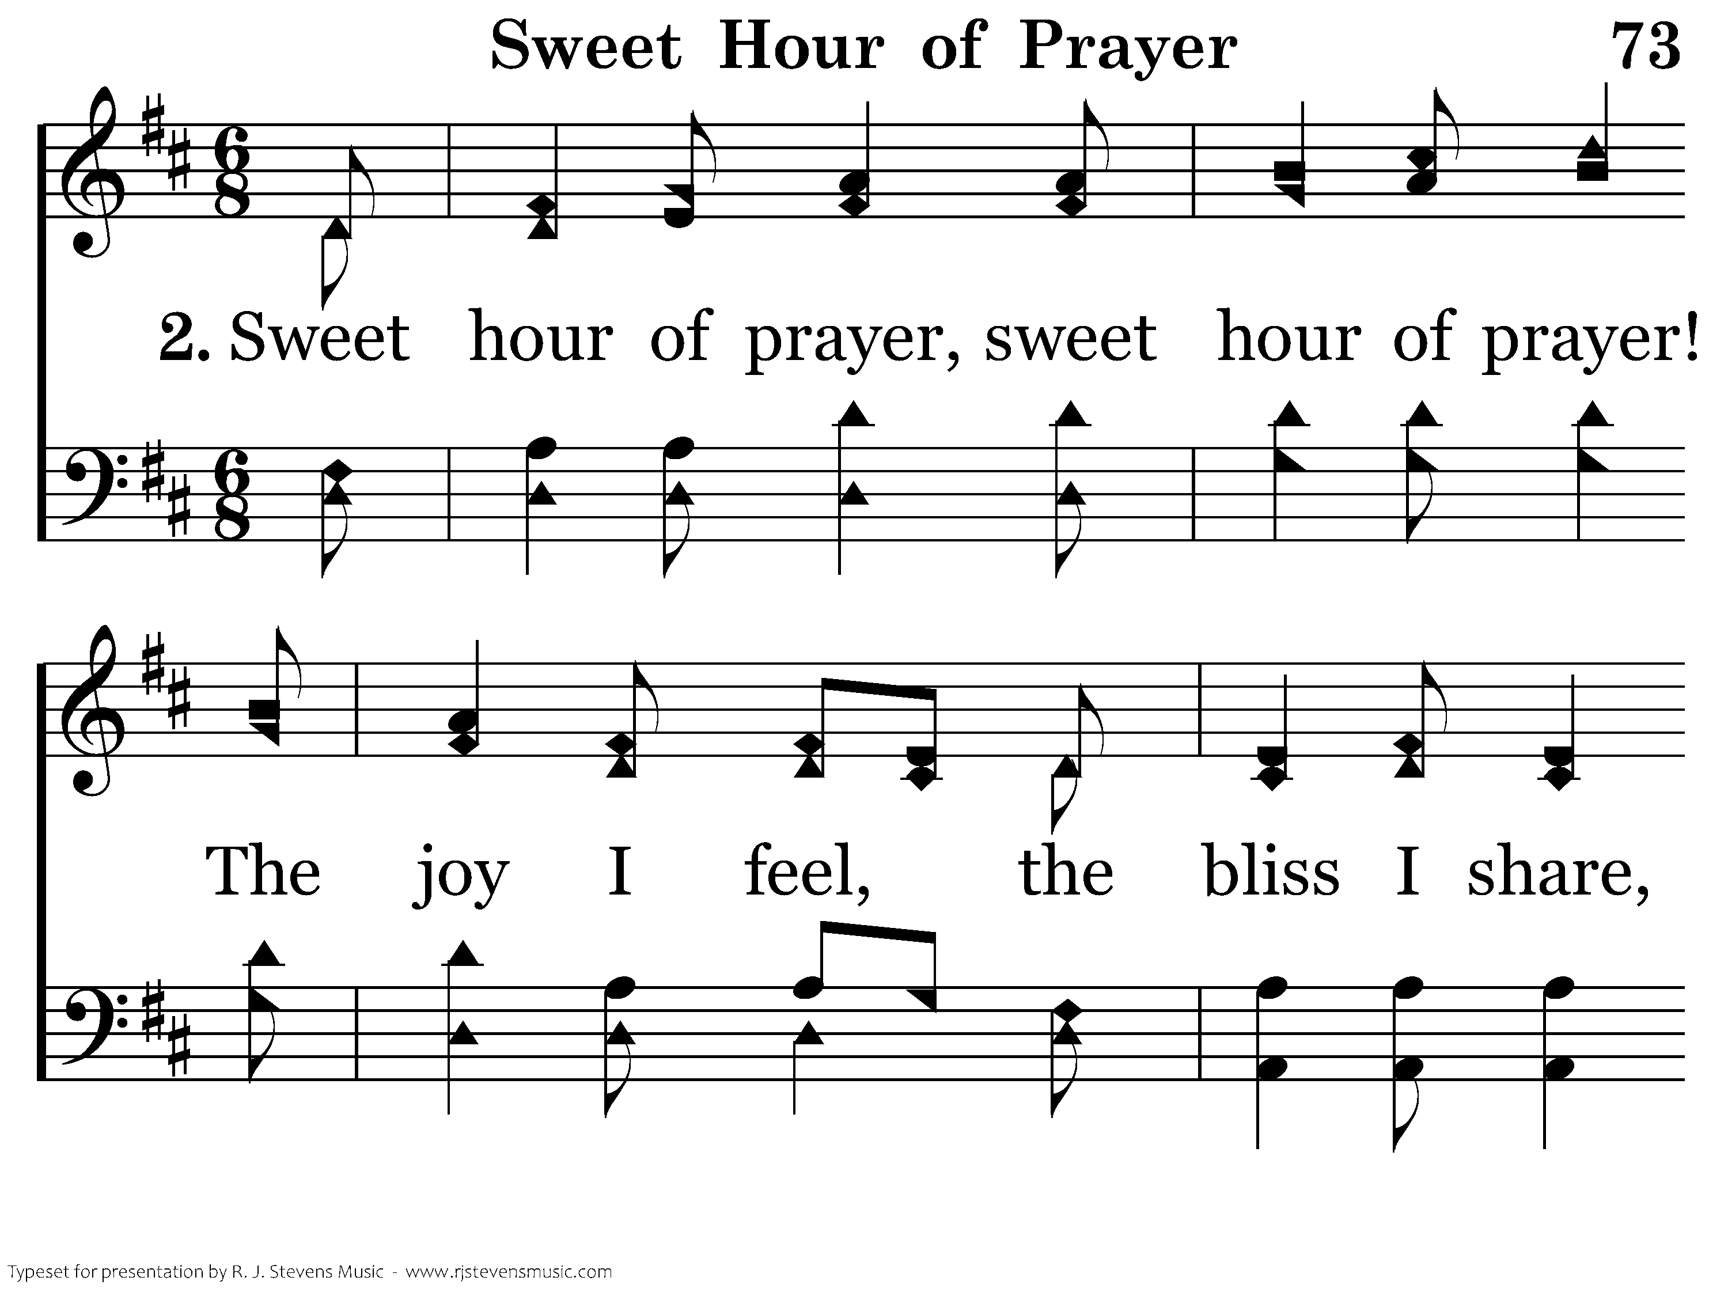
073 - Sweet Hour Of Prayer - 2.1
CCLI #21593236

Slide 7
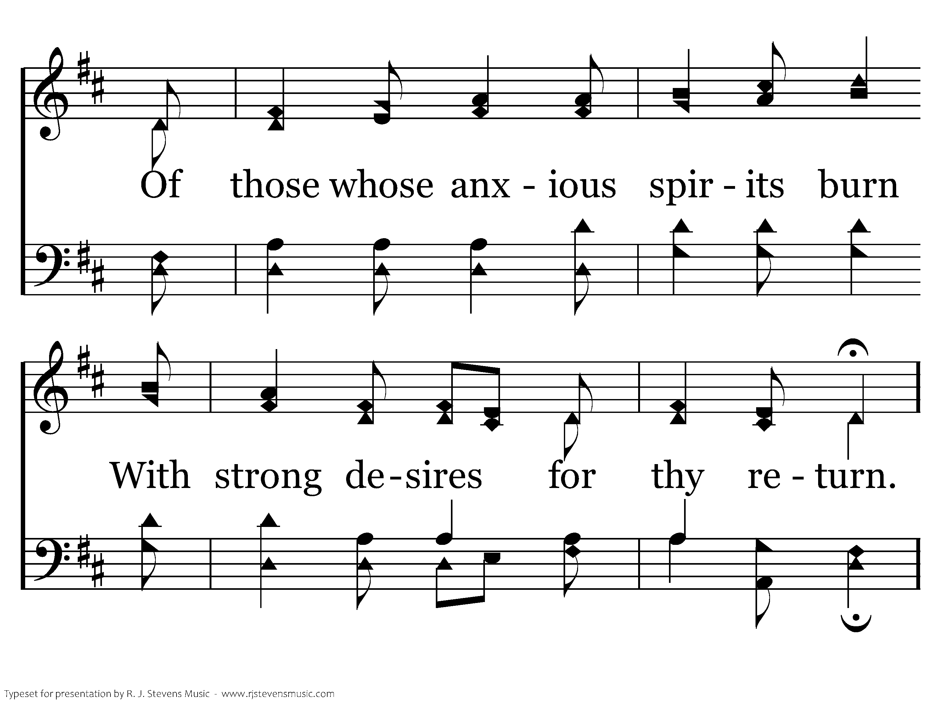
073 - Sweet Hour Of Prayer - 2.2
CCLI #21593236

Slide 8
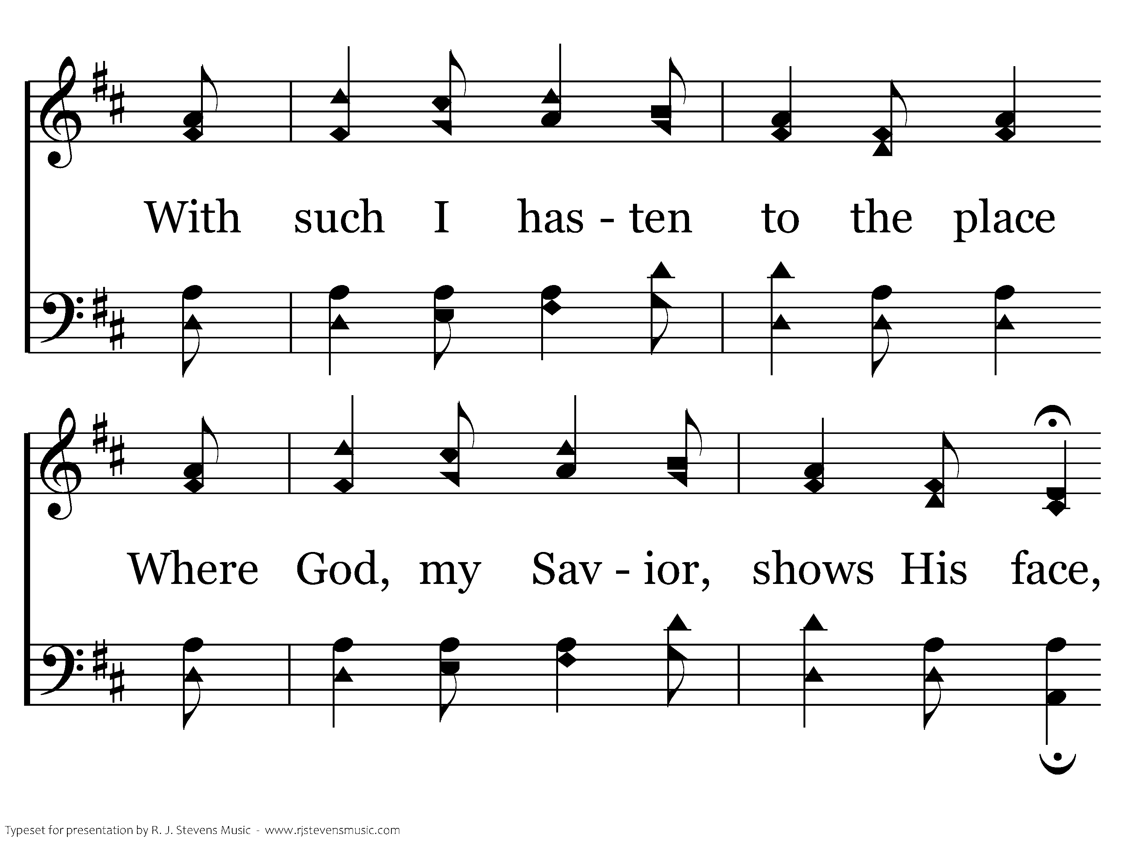
073 - Sweet Hour Of Prayer - 2.3
CCLI #21593236

Slide 9
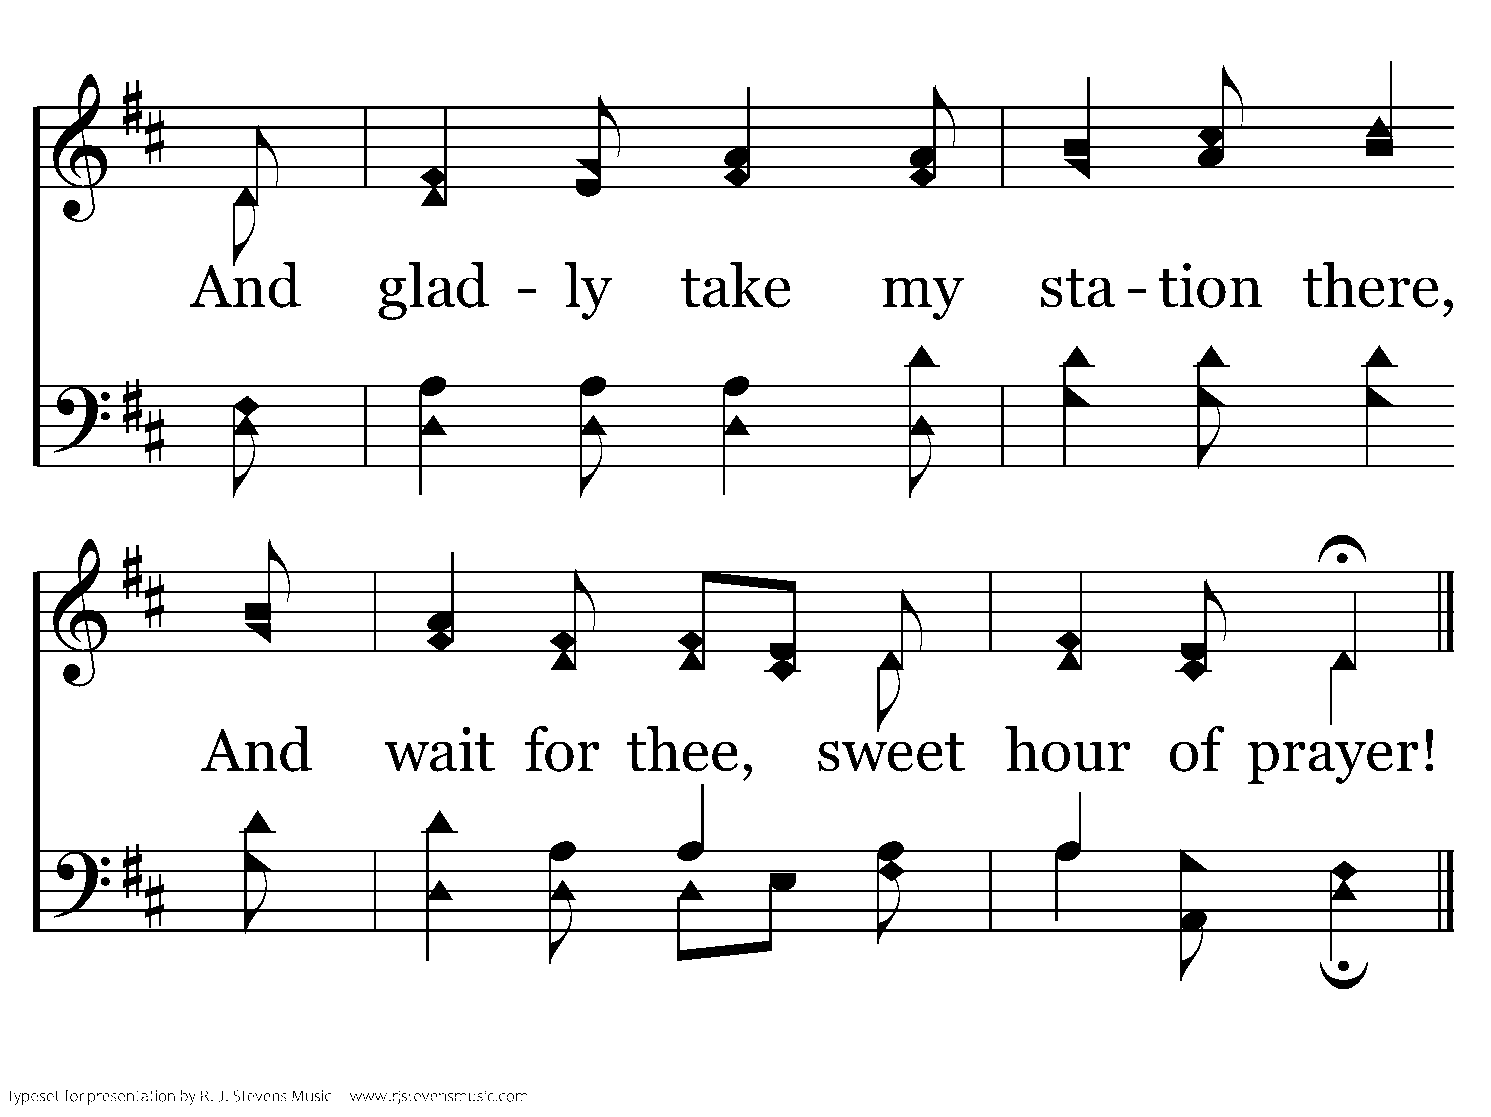
073 - Sweet Hour Of Prayer - 2.4
CCLI #21593236
End of Verse 2

Slide 10
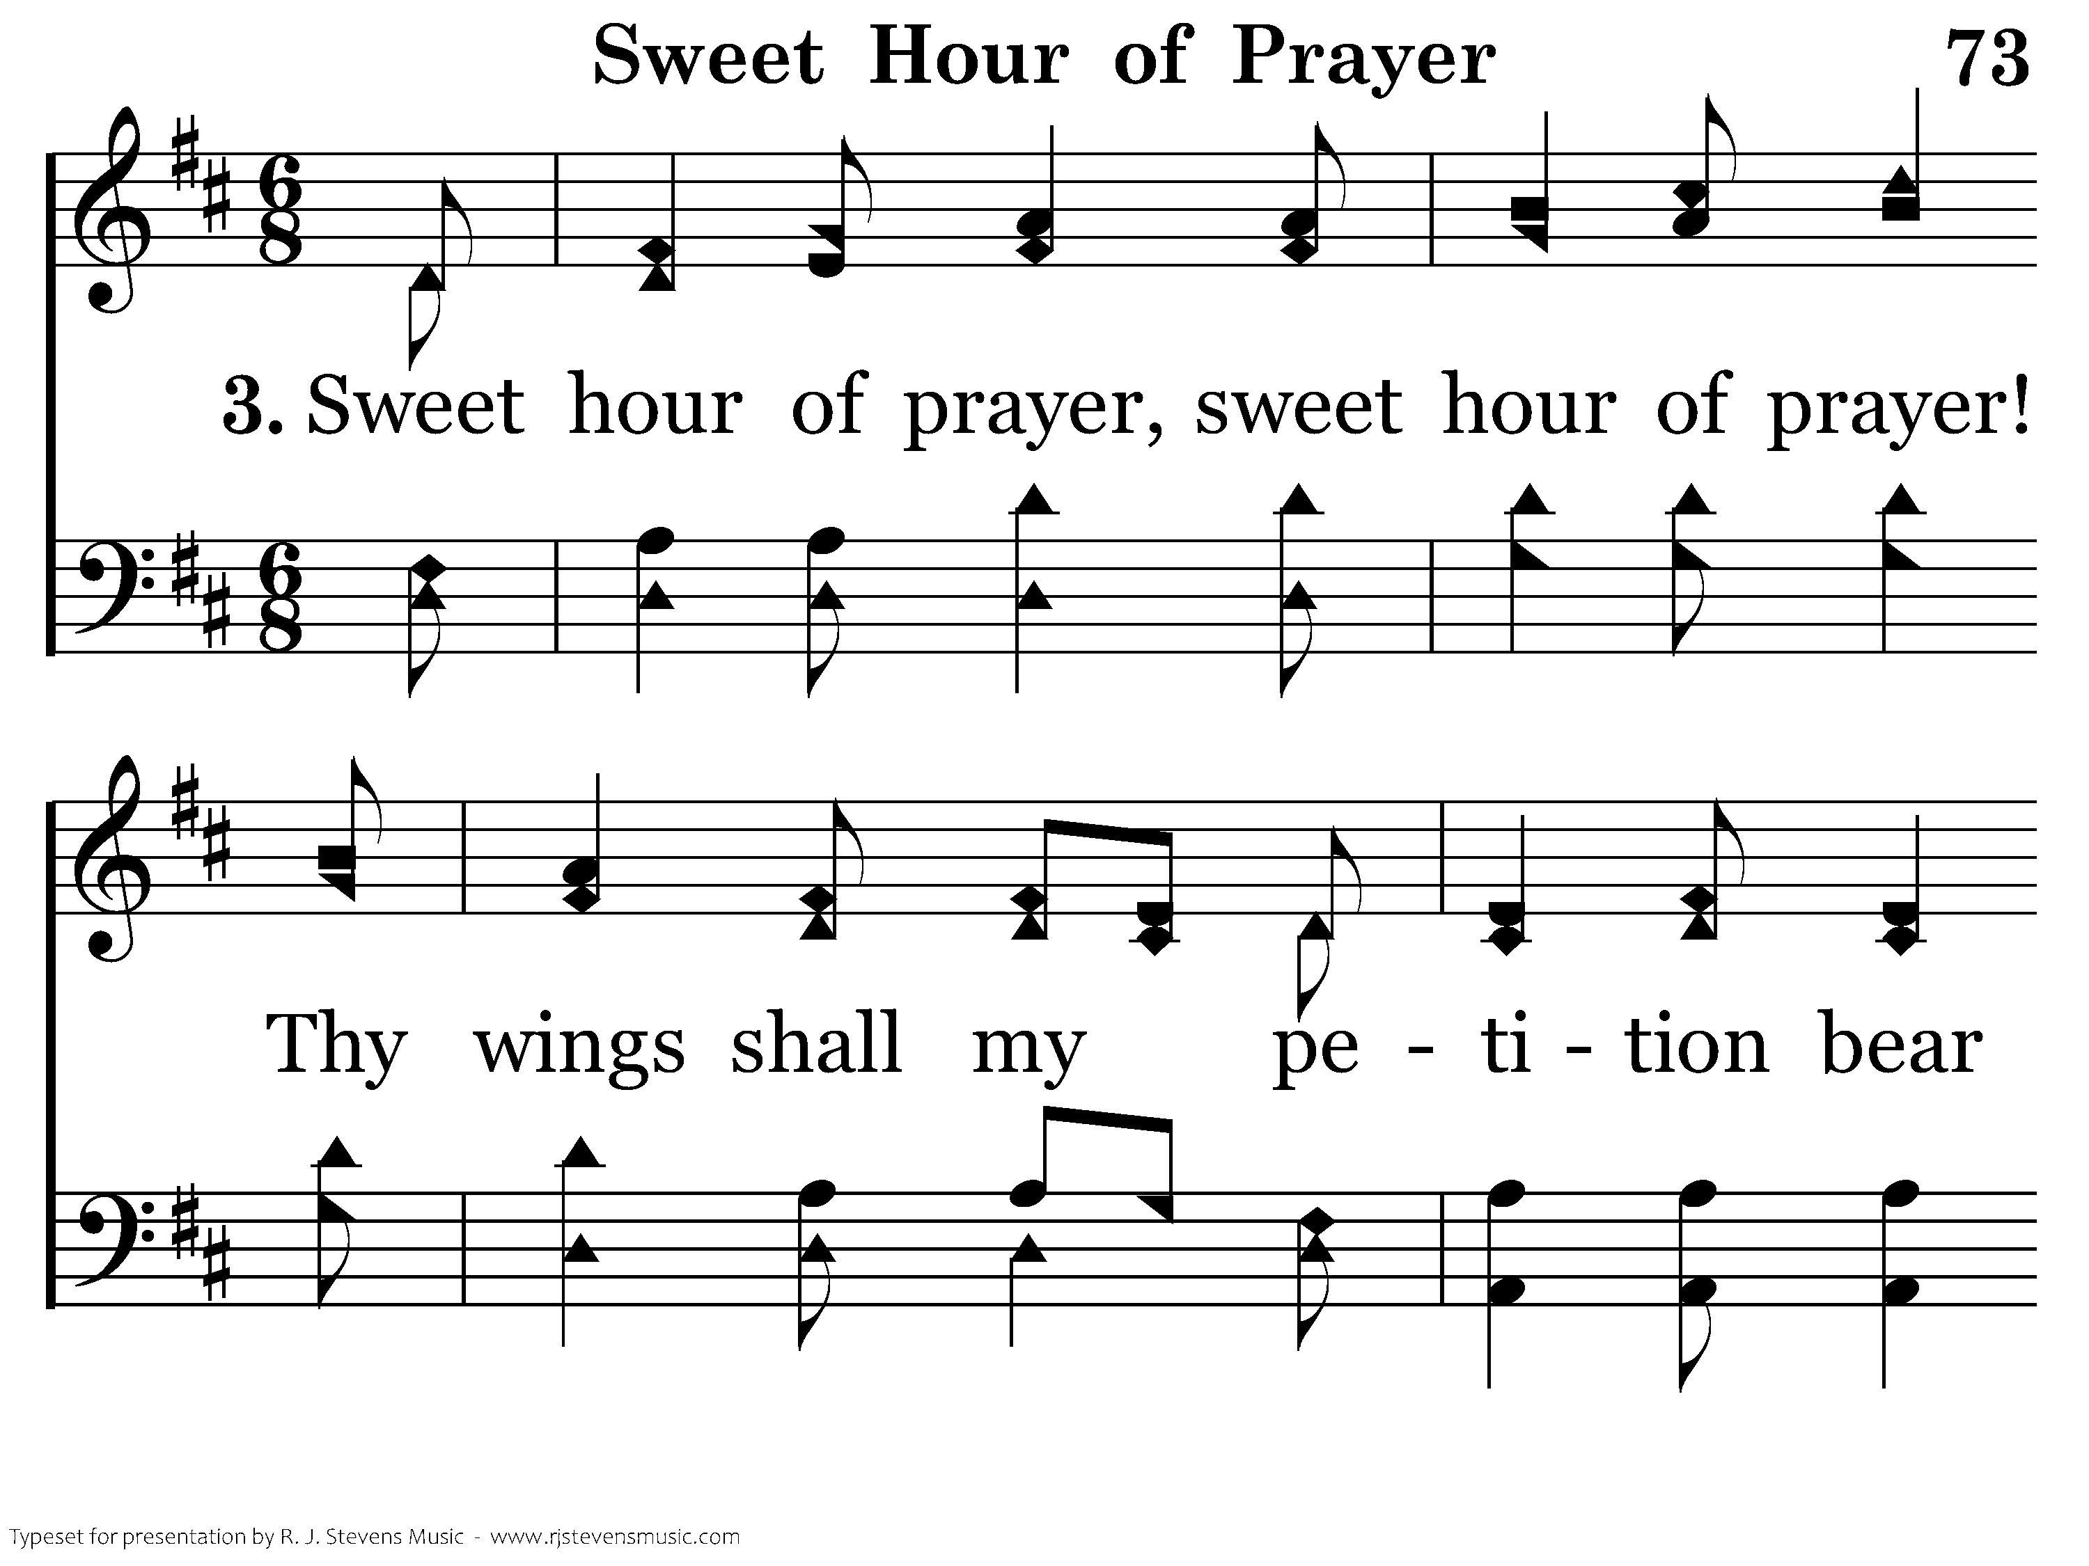
073 - Sweet Hour Of Prayer - 3.1
CCLI #21593236

Slide 11
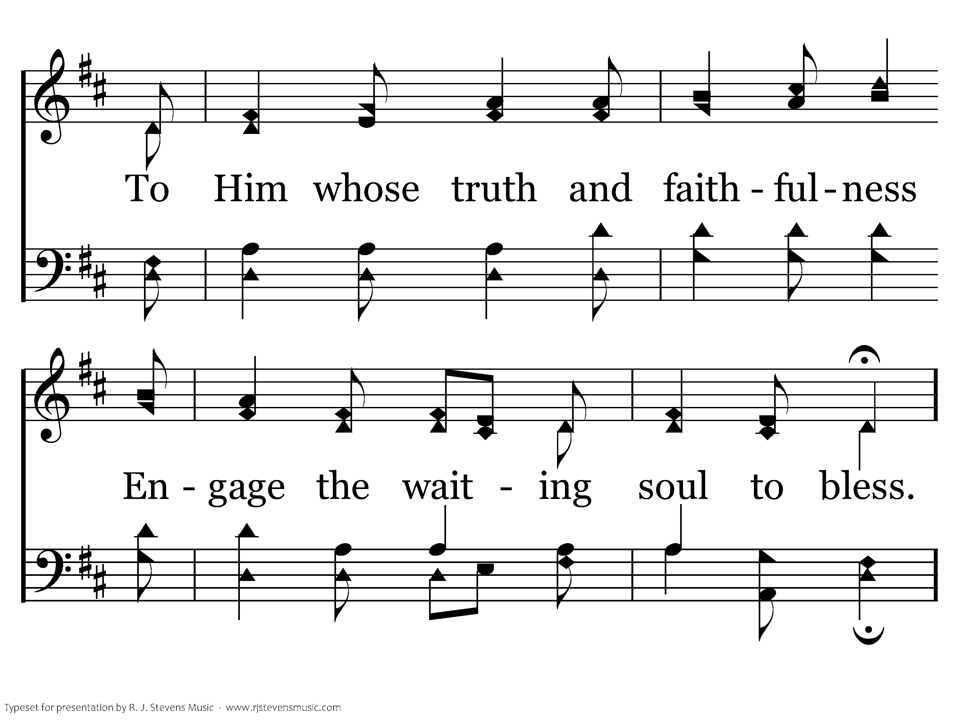
073 - Sweet Hour Of Prayer - 3.2
CCLI #21593236

Slide 12
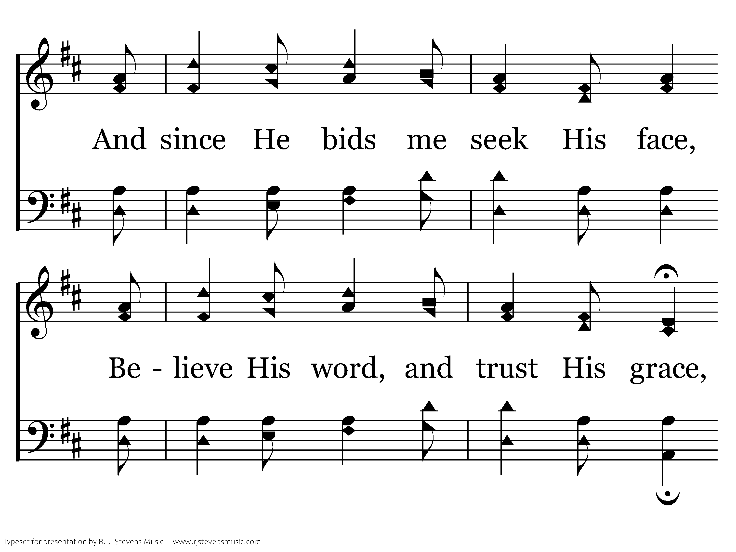
073 - Sweet Hour Of Prayer - 3.3
CCLI #21593236

Slide 13
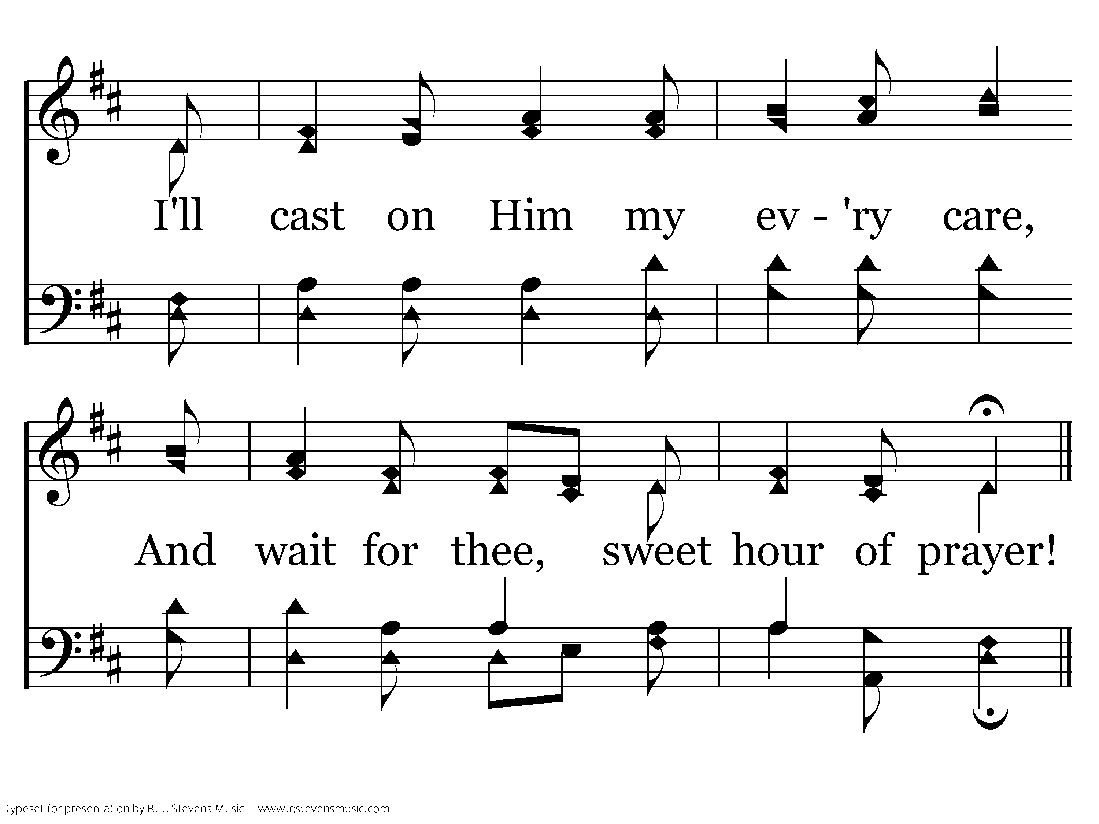
073 - Sweet Hour Of Prayer - 3.4
CCLI #21593236
End of Song

